Slide 1
SHOPNOW
PROJECT 4
End-to-End DevOps Pipeline for a Web Application with CI/CD
ShopNow: Production MERN Microservices Deployment on AWS EKS
SUBMITTED BY
Anupam Kumar
anupam66kumar@gmail.com
PROGRAM
Multicloud Architecture and DevOps Program
Hero Vired
MENTORS
Mohan Krishna|Chirag Goel|Prashanth Dey

Slide 2

Automating Deployment Lifecycle
Replacing Monolithic Setups with Resilient MERN Microservices on AWS EKS
CORE OBJECTIVE
"Build an automated, zero-touch deployment lifecycle for the ShopNow application. This replaces monolithic server setups with a resilient microservices architecture running on AWS EKS, managed via GitOps/Declarative CI/CD pipelines, and monitored with Prometheus and Grafana."
Infrastructure as Code
Modular Terraform code to provision a multi-AZ VPC, EKS Cluster, and EC2 Spot worker node groups.
Stateful Persistence
Kubernetes StatefulSet for MongoDB backed by AWS EBS gp3 dynamic provisioning.
Configuration Management
Ansible playbooks for cluster controller bootstrap.
Ingress Routing
Path-based micro-frontend routing directing external traffic to Storefront, Admin Dashboard, and REST API services through a single AWS Load Balancer.
Automated CI/CD Pipelines
Multi-stage Jenkins declarative pipelines triggered by GitHub Webhooks to test, build, push container images to private Amazon ECR, and roll out deployments.
Full-Stack Observability
Full-stack observability utilizing the kube-prometheus-stack with live Grafana dashboards.

Slide 3
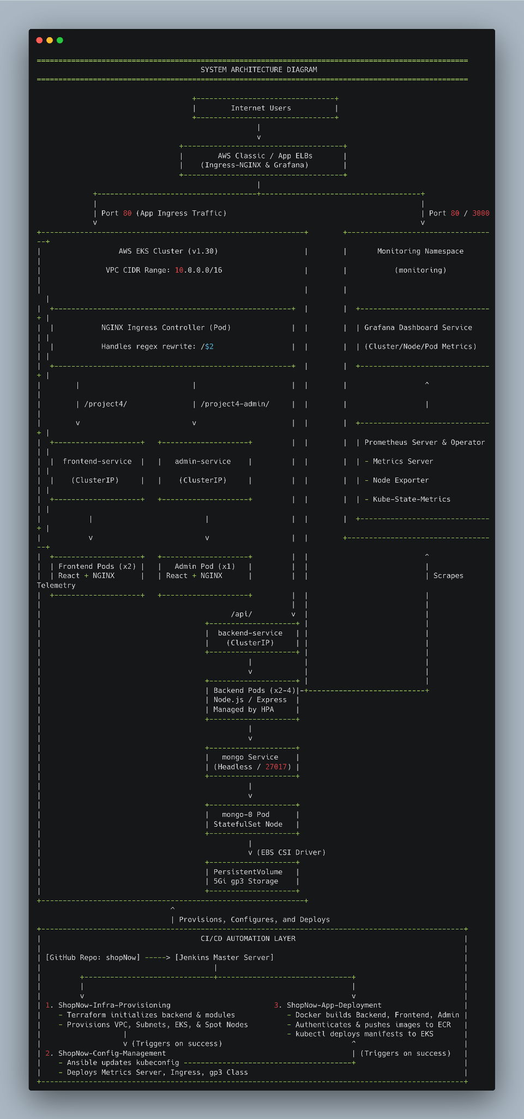
AWS EKS Cluster Architecture (v1.30)
Microservices routing, stateful persistence, and telemetry monitoring
Ingress & Microservices Routing
VPC CIDR Range: 10.0.0.0/16 via AWS Classic / App ELBs
NGINX Controller: Handles regex rewrite /$2
/project4/ → Frontend Pods (React + NGINX, x2)
/project4-admin/ → Admin Pods (React + NGINX, x1)
/api/ → Backend Pods (Node.js/Express, x2-4 HPA)
System Architecture Diagram
Stateful Database Layer
Mongo Service: Headless service targeting mongo-0 Pod
StatefulSet Node: Backed by AWS EBS CSI Driver
Storage Provision: 5Gi gp3 PersistentVolume
Cluster Telemetry & Monitoring
Dedicated monitoring namespace scraping telemetry across nodes and pods.
Prometheus Server & Operator, Metrics Server
Node Exporter & Kube-State-Metrics
Grafana Dashboard Service (Metrics visualization)

Slide 4
Strategic Technology Selections
Prioritizing deep AWS integration, cost reduction, and open-source observability.
70%
COST REDUCTION VIA EC2 SPOT INSTANCES
COMPONENT
ALTERNATIVE
ENGINEERING RATIONALE
AWS EKS (v1.30)
Self-Managed K8s
Eliminates control-plane management overhead.
EC2 Spot (t3.medium)
On-Demand Instances
Achieves up to 70% cost reduction in dev while testing stateless failover resilience.
CORE REGION & PLATFORM
AWS (Asia Pacific - Sydney)
Selected over GCP/Azure for deep EKS integration, ECR support, and fine-grained IAM Role policies for CSI drivers.
OBSERVABILITY & CI/CD
Open-source Prometheus Operator and Grafana eliminate CloudWatch ingestion fees. Jenkins Pipelines ensure full on-premise pipeline ownership.
Amazon Linux 2023
Amazon Linux 2
AL2 bootstrap scripts deprecated in K8s 1.30+; AL2023 uses standardized systemd init.
StatefulSet + EBS (gp3)
RDS / DocumentDB
Demonstrates native K8s volume persistence and dynamic PVC life-cycles.
NGINX Ingress
AWS ALB Ingress
Lightweight, supports rapid local regex rewriting rules, and avoids multi-ALB billing.
Jenkins Pipelines &
Prometheus/Grafana
GitHub Actions &
CloudWatch Insights
Jenkins provides full pipeline ownership; Prometheus/Grafana eliminates per-metric CloudWatch fees.

Slide 5
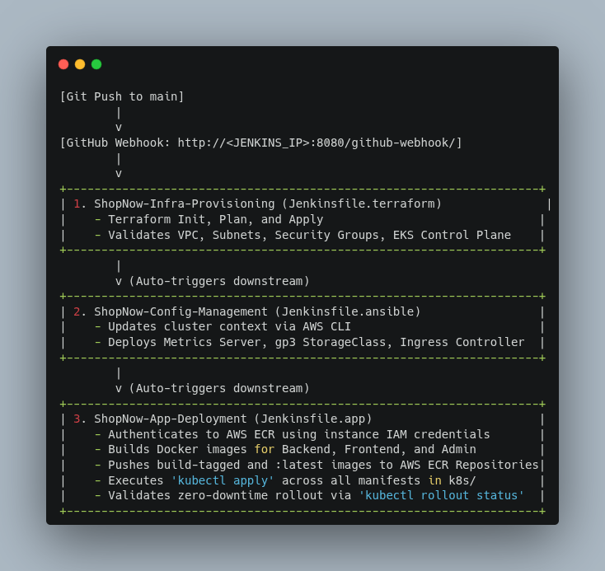
3-Tier Chained Pipeline Architecture
Automated infrastructure provisioning, configuration management, and application deployment
TRIGGER: GIT PUSH TO MAIN → GITHUB WEBHOOK → JENKINS MASTER
AUTOMATED PIPELINE ARCHITECTURE & JENKINS STAGES
Stage 1: ShopNow-Infra-Provisioning (Jenkinsfile.terraform)
• Executes Terraform Init, Plan, and Apply
• Validates & provisions VPC, Subnets, Security Groups, EKS Control Plane, and Spot Nodes
Stage 2: ShopNow-Config-Management (Jenkinsfile.ansible)
• Auto-triggered downstream upon Stage 1 success
• Updates cluster context via AWS CLI
• Deploys Metrics Server, gp3 StorageClass, and Ingress Controller
Stage 3: ShopNow-App-Deployment (Jenkinsfile.app)
• Authenticates to AWS ECR using instance IAM credentials
• Builds & pushes tagged/latest images for Backend, Frontend, Admin
• Executes kubectl apply across manifests in k8s/ & validates rollout

Slide 6
Deployment Runbook
Sequential execution of Infrastructure, Configuration, and Kubernetes Rollout
Prerequisites: AWS CLI (IAM Admin) | Terraform v1.5+ | Ansible v2.15+ | Docker | kubectl (k8s v1.30)
STEP 1: INFRASTRUCTURE (IaC)
STEP 2: CONFIG MANAGEMENT
STEP 3: APPLICATION ROLLOUT
Provision cloud resources & cluster context via Terraform.
# Navigate to directory
$ cd terraform/
# Initialize provider
$ terraform init
# Apply infrastructure
$ terraform apply \
-var-file="terraform.tfvars" \
-auto-approve
# Update local kubeconfig
$ aws eks update-kubeconfig
✔ EKS Cluster & VPC created
✔ Kubeconfig context populated
Configure cluster controllers & essential storage classes.
# Navigate to directory
$ cd ansible/
# Run playbook
$ ansible-playbook \
-i inventory/hosts.ini \
playbook.yml
# Verify controllers
$ kubectl get sc,ingressclass
✔ Ingress controller bootstrapped
✔ Storage class readiness verified
Deploy namespace, stateful DB, microservices, & ingress.
# Create namespace & DB
$ kubectl apply -f ns.yaml
$ kubectl apply -f mongodb.yaml
# DB Auth Init
USER: shopuser | PASS: ShopNowPass123
# Deploy microservices
$ kubectl apply -f backend/ -f frontend/ -f admin/ -f ingress/
# Confirm status
$ kubectl rollout status \
deploy --timeout=120s
✔ shopnow-demo namespace live
✔ Full stack rollout confirmed

Slide 7
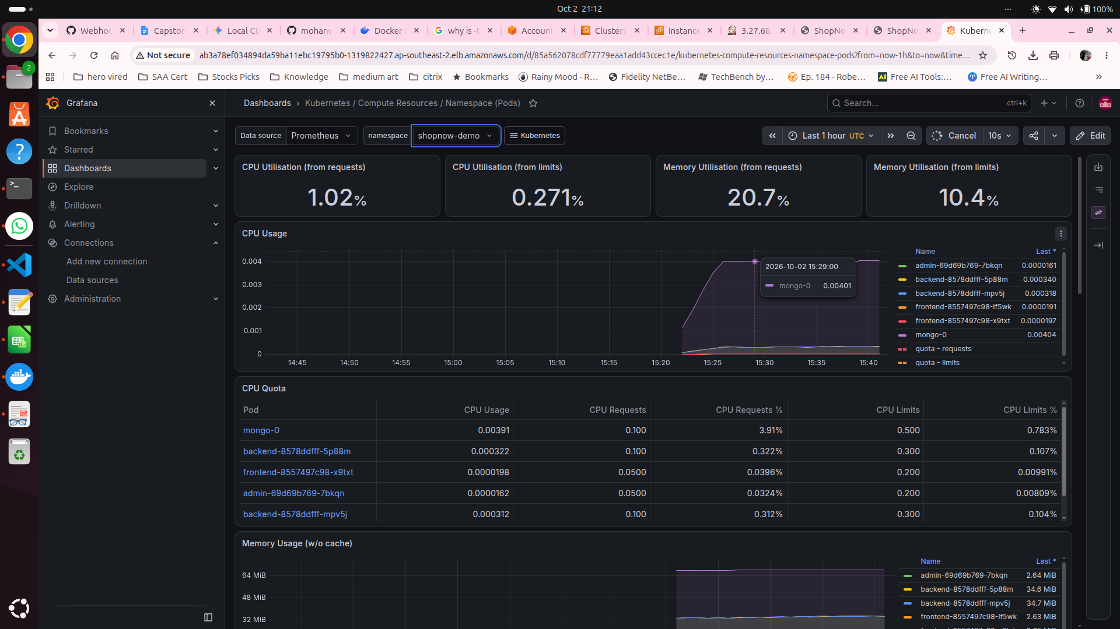
Grafana Observability & Monitoring
Comprehensive real-time metric tracking via kube-prometheus-stack Helm chart
01. Helm Deployment Details
Live Dashboard View: shopnow-demo
CHART & NAMESPACE
prometheus-community/kube-prometheus-stack
Namespace: monitoring
02. Service Configuration & Resources
Service Type: LoadBalancer
Configured for external access via Load Balancer DNS
Resource Requests: 100m CPU / 256Mi RAM
Guaranteed base allocation for Grafana instance
03. Access & Dashboard Scope
Dashboard Path: Kubernetes / Compute Resources / Namespace (Pods)
Target Namespace: shopnow-demo
Delivers real-time metrics across cluster, nodes, and individual pods, including CPU, memory utilization, network traffic, and quota constraints.
Key Tracked Telemetry
• CPU Utilisation: Tracked against requests (1.02%) & limits (0.271%)
• Memory Utilisation: Monitored requests (20.7%) & limits (10.4%)
• Pod Workloads: Pod level metrics for mongo-0, backend, frontend

Slide 8
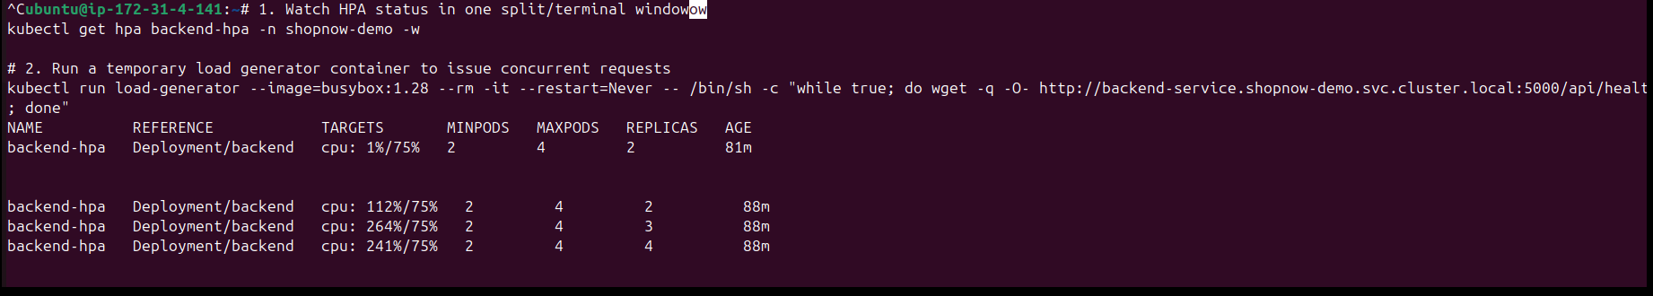
Automated Resilience & HPA Verification
Validated via pod self-healing capabilities and dynamic Horizontal Pod Autoscaling CPU thresholds.
EXECUTION & VALIDATION TESTS
TERMINAL EXECUTION & HPA MONITORING
Test 1: Pod Self-Healing Verification
Manually deleted active backend pod to verify state reconciliation:
kubectl delete pod -n shopnow-demo -l app=backend --now
Result: Kubernetes automatically reconciled desired state, immediately provisioning a replacement replica.
ubuntu@ip-172-31-4-141: ~ (hpa-load-test)
TERMINAL LOG HIGHLIGHTS
1. HPA Monitor:
kubectl get hpa backend-hpa -n shopnow-demo -w
2. Load Generator:
kubectl run load-generator --image=busybox:1.28 ...
Scaling Metric Progression:
• Baseline: CPU 1%/75% | Replicas: 2
• Load Spike: CPU 112%/75% -> 264%/75%
• Autoscale Triggered: Replicas scaled 2 -> 3 -> 4 (MAX)
Test 2: Horizontal Pod Autoscaler (HPA)
Generated simulated HTTP traffic targeting /api/products and /api/health to trigger CPU thresholds exceeding 75% utilization.
Observed Result: backend-hpa automatically scaled replica count from 2 to 4 pods once CPU target spiked past 75%.
Cooldown: Upon terminating the load generator, replicas successfully cooled down and scaled back to the baseline of 2 pods.

Slide 9
Systematic DevOps Bottleneck Resolution
Diagnosed and resolved critical issues across Docker, IAM, environment variables, security groups, and ingress routing.
ISSUE 1: DOCKER PERMISSIONS
ISSUE 2: MONGODB VOLUME STUCK
ISSUE 3: BACKEND BOOT FAILURE
Docker Daemon Socket Permission Denied error during deployment execution.
MongoDB Volume Stuck in Pending state because Spot worker node IAM role lacked EBS permissions.
Backend Boot Failure caused by mismatched environment variables and invalid probe paths.
RESOLUTION
RESOLUTION
RESOLUTION
Added jenkins user to docker UNIX group and set chmod 666 on /var/run/docker.sock.
Attached AmazonEBSCSIDriverPolicy policy to the Spot worker node IAM role.
Standardized MONGODB_URI / MONGO_URI to mongodb://mongo:27017/shopnow & set liveness probe to /api/health.
ISSUE 4: CROSS-SUBNET INGRESS TIMEOUT
ISSUE 5: SPA SUB-PATH 404 ERRORS
Network traffic timeouts occurring across multi-subnet node communication channels.
Single Page Application sub-paths returning HTTP 404 errors on browser refresh or direct navigation.
RESOLUTION
RESOLUTION
Added Node Security Group ingress rule allowing cross-node overlay traffic (-1) and VPC CIDR 10.0.0.0/16.
Configured ingress regex path capture /project4(/|$)(.*) and added rewrite-target: /$2 annotation.

Slide 10
Resource Teardown Sequence
Systematically decommission Kubernetes workloads, infrastructure, and EC2 instances to eliminate ongoing AWS costs.
01. KUBERNETES & HELM
02. INFRASTRUCTURE
03. EC2 TERMINATION
STEP 1: DELETE K8S RESOURCES
Uninstall active Helm releases and delete cluster namespaces to halt running application workloads.
STEP 2: TERRAFORM DESTROY
Destroy all provisioned AWS cloud infrastructure automated via Terraform IaC execution.
STEP 3: DECOMMISSION EC2
Stop or terminate the Jenkins Master Server EC2 instance directly from the AWS EC2 Console.
BASH / KUBECTL
TERRAFORM CLI
AWS CONSOLE ACTION
# 1. Uninstall Helm release
$ helm uninstall monitoring -n monitoring
# 2. Delete namespaces
$ kubectl delete namespace shopnow-demo monitoring
# 1. Navigate to IaC dir
$ cd terraform/
# 2. Destroy infrastructure
$ terraform destroy -var-file="terraform.tfvars" -auto-approve
# Target Instance
Jenkins Master Server
# Management Steps
1. Open AWS EC2 Console
2. Select Jenkins Instance
3. Instance State -> Terminate

